Slide 1
The Whys and Hows of Prototyping
Bring paper prototype examples
Add discussion HW0 / points
Programming Usable Interfaces (PUI)
05-430 / 05-630 Fall 2018
Jason Hong
jasonh@cs.cmu.edu
Notes:
Videos to preload:
http://www.youtube.com/watch?v=M66ZU2PCIcM
https://www.youtube.com/watch?v=7QmCUDHpNzE
For next time
- Wizard of Oz
Show Wendy Ju's examples for trash can

Slide 2
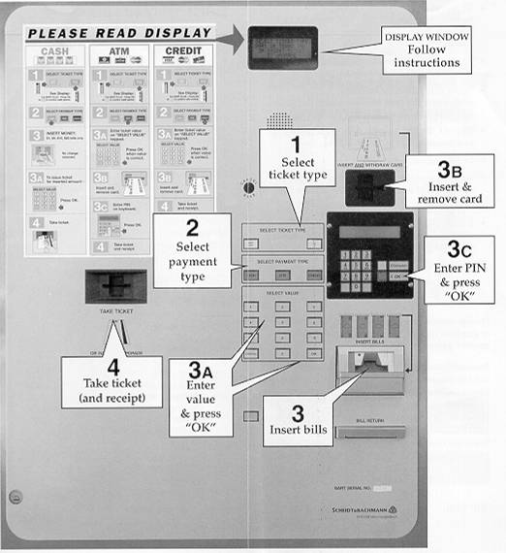

Slide 3
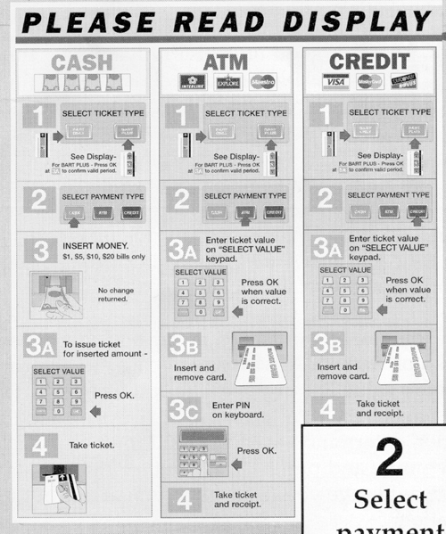

Slide 4
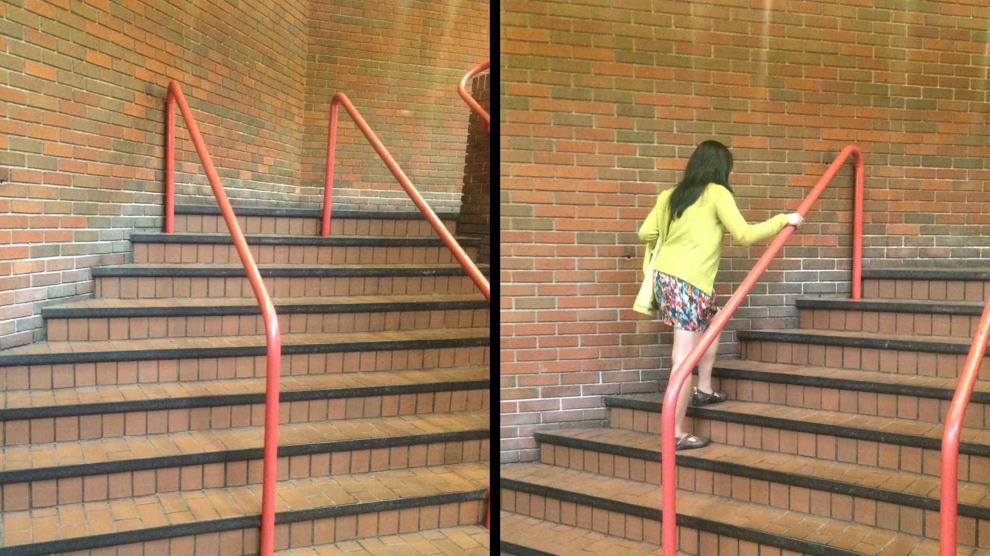
UI Hall of Fame or Shame?
Notes:
This is in Station Square in Pittsburgh
Definitely broken

Slide 5
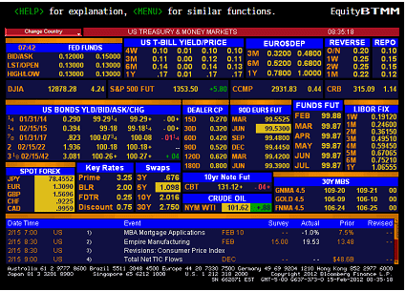
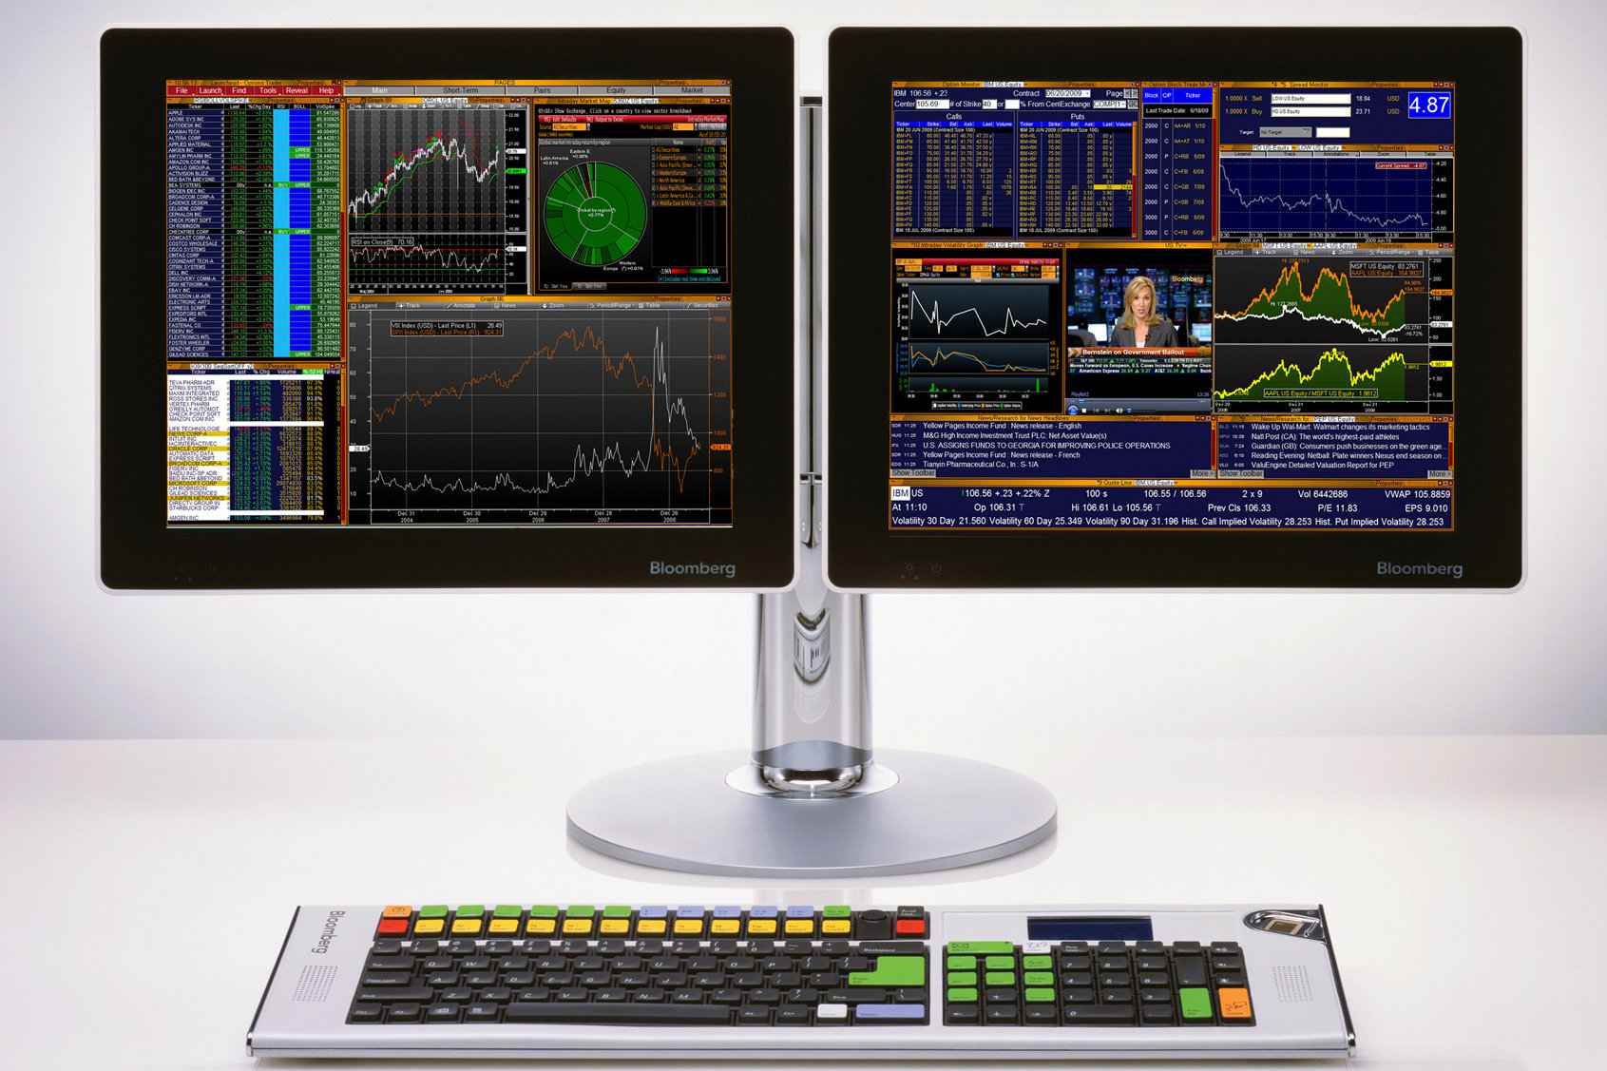
UI Hall of Fame or Shame?
Notes:
Bloomberg terminal UI
This is a good example of tricycle vs bicycle. Definitely not a walk-up-and-use interface. But can be very effective for people who are trained on it.

Slide 6
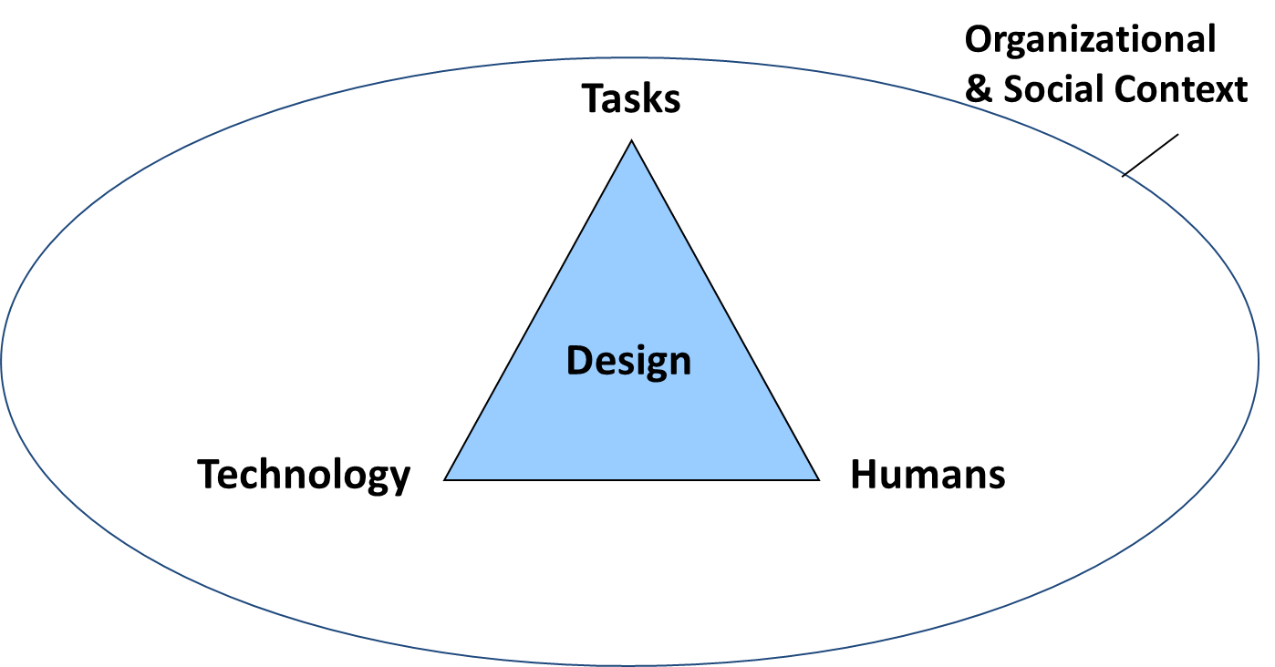

Recap of Last Time What is Design?
You are not the user
Great UX requires empathy
Iterative Design with Progressive Refinement
Many ways of measuring usability
Depends on your goals
Useful, usable, desirable
Design from Data
Design
Prototype
Evaluate

Slide 7
Overview of Today
Why Prototype?
Low-fidelity and High-fidelity Prototypes
Paper Prototyping
Wizard of Oz
Some advanced prototyping concepts
Running user studies

Slide 8
Why Prototype?
Prototyping means building simplified versions of the system
Can get feedback on your design faster
Validate assumptions quickly
Fix problems before code is written
Saves time + money by finding bugs early in process
Can quickly experiment with alternatives
Can keep the design centered on the user
Test and observe ideas with users

Slide 9
Iterative Design
Short cycles of design, prototype, evaluate
Use prototypes to drive process
Progressive refinement at each iteration (next slide)
Again, no overarching grand unified theory of UX design
Instead, best practice of doing as many cycles
Generally, more cycles -> better design
Design
Prototype
Evaluate
Notes:
Don’t have a lot of hard constraints as in other areas of engineering
Iterative Design works really well
Generally, more cycles you go thru, the better

Slide 10
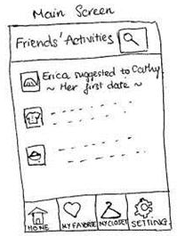
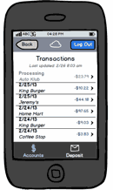
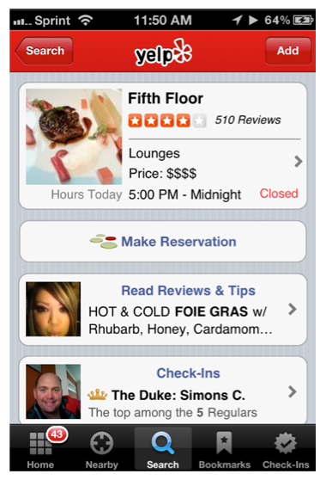
Example of Progressive Refinement
Note: not the same app
Notes:
These three are not the same app, just an example of progressive refinement
Low-fi from http://resources.infosecinstitute.com/wp-content/uploads/112712_2207_LowFidelity1.jpg
Med-fi from Balsamiq examples
High-fi from Yelp

Slide 11
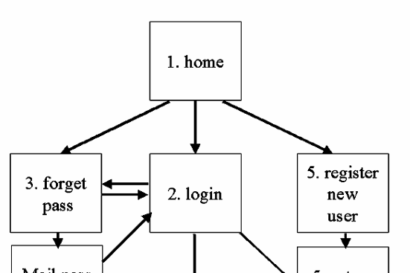
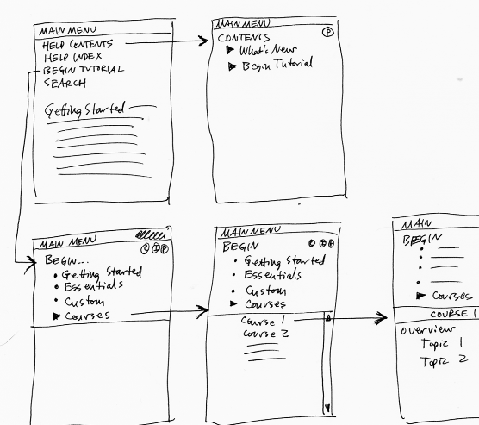
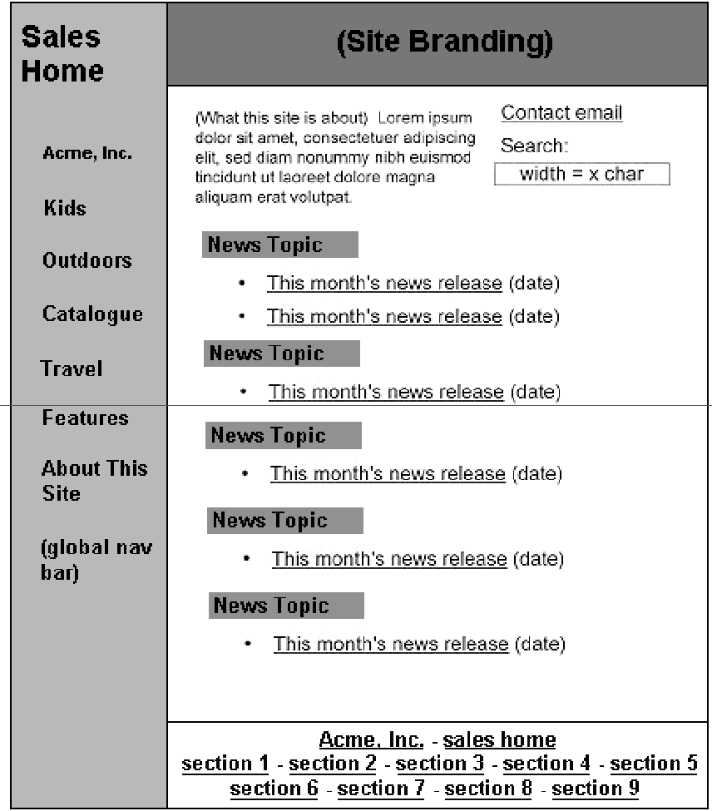

Design Representations
Site Maps
Storyboards
Schematics
Mock-ups
Notes:
Designers create representations of sites at multiple levels of detail
Web designs are iteratively refined at all levels of detail
Three scales: entire site or app, storyboards or scenarios, and individual screens or web pages

Slide 12
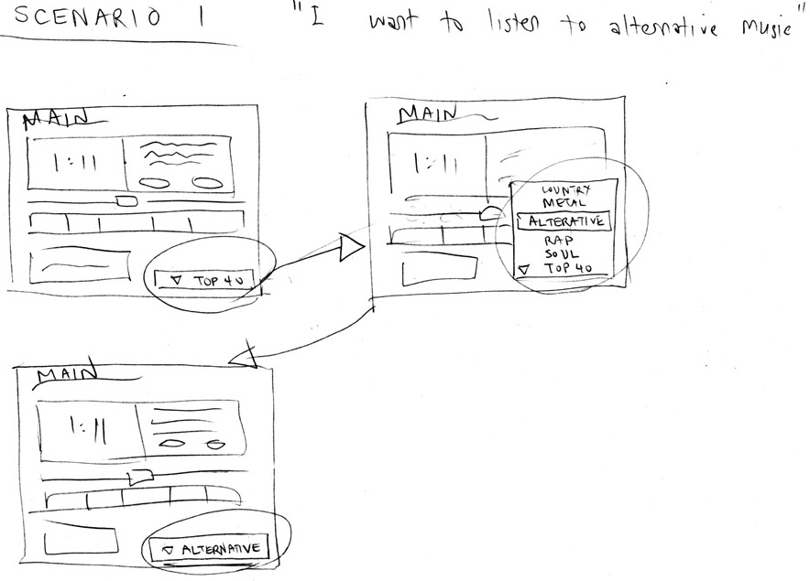
Fidelity in Prototyping
Fidelity is level of detail
High fidelity
Prototype looks like the final product
Low fidelity
Artist’s rendition with many details missing

Slide 13
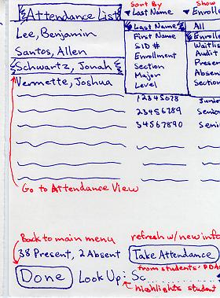
Low-Fi Sketches and Storyboards
Note lack of detail for “unimportant” things
Note use of greeking for unimportant text

Slide 14
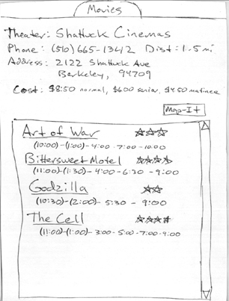
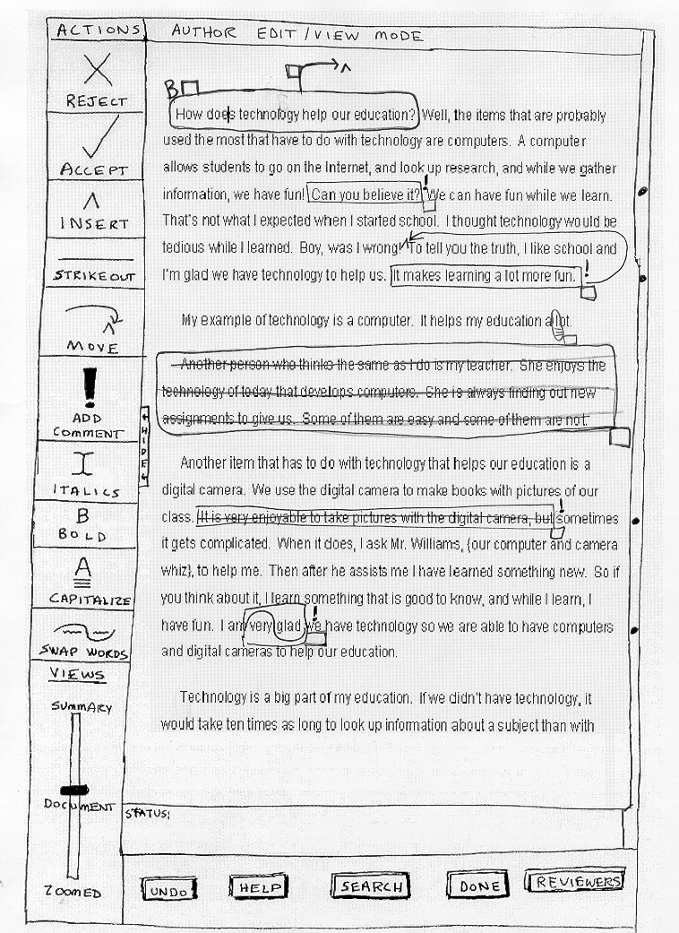
Low-Fi Sketches and Storyboards
Note combination of printed text + sketchy parts too

Slide 15
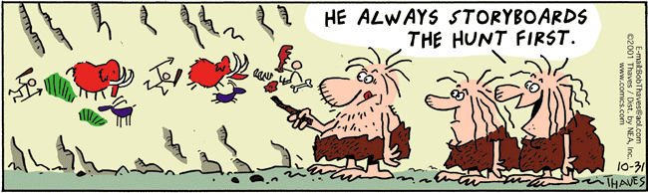
Low-Fi Sketches and Storyboards
Where does term “storyboards” come from?
Film and animation
Give you a “script” of important events
Leave out the details
Concentrate on the important interactions

Slide 16
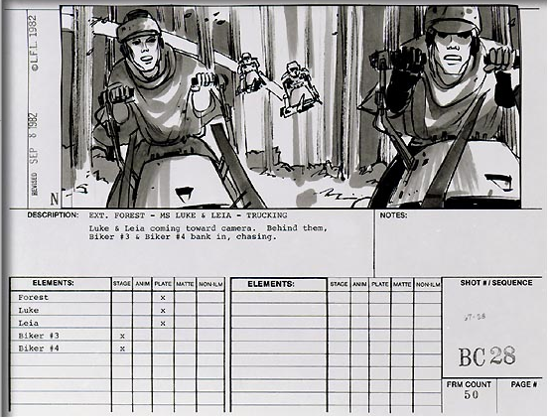
Notes:
What movie is this from?
Note the relative “cheap” production cost compared to actual filming
Also note how expensive it would be to fix this after filming vs before filming

Slide 17
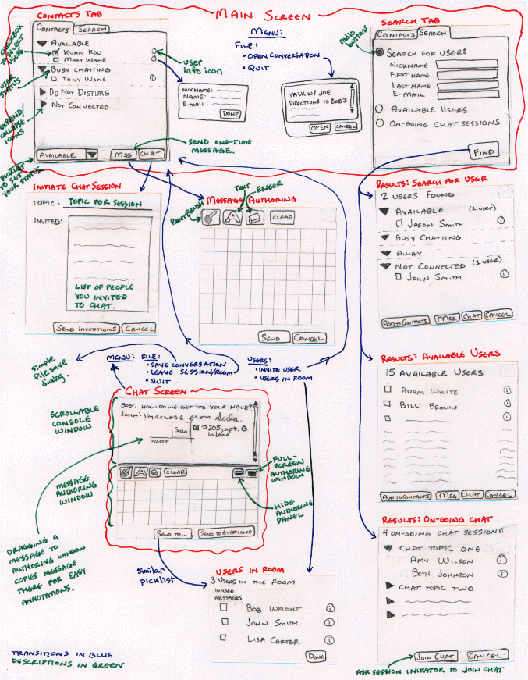
Ink Chat

Slide 18
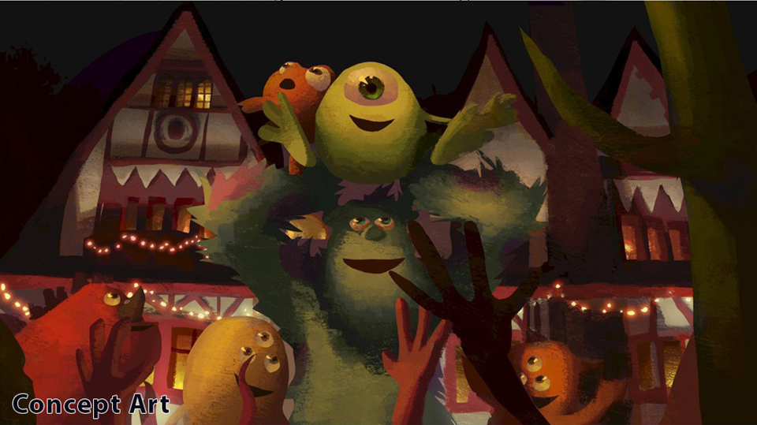
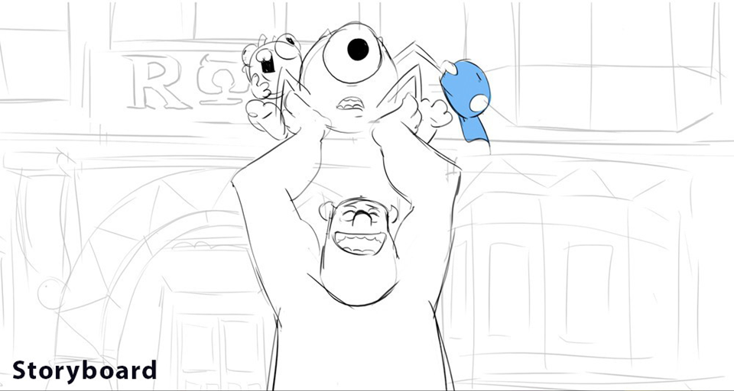
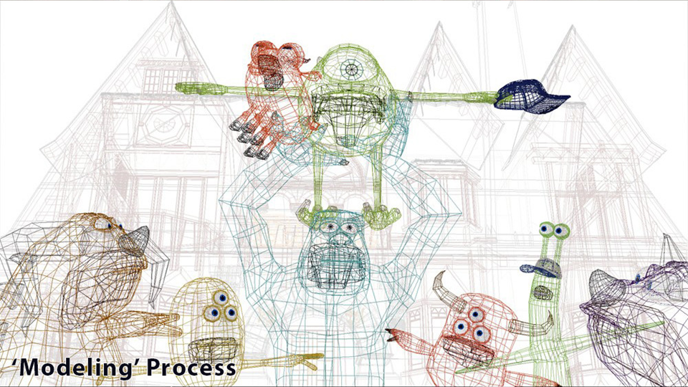
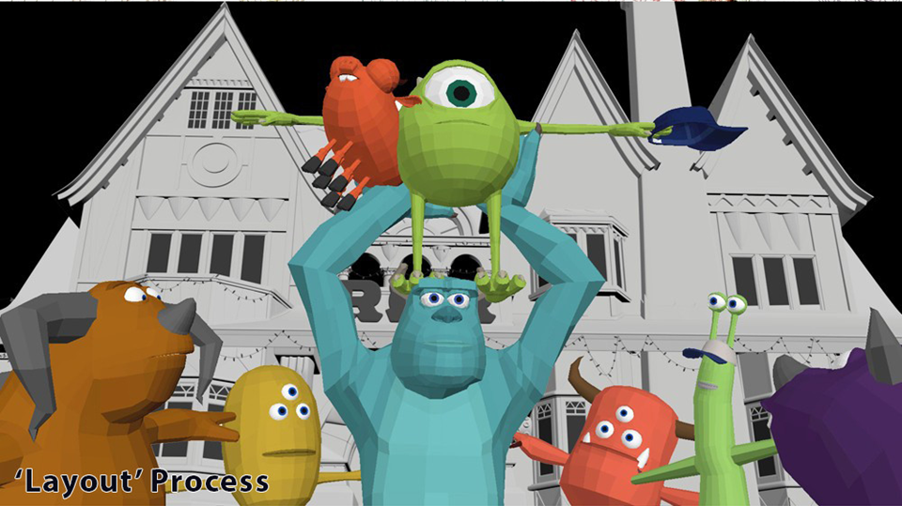
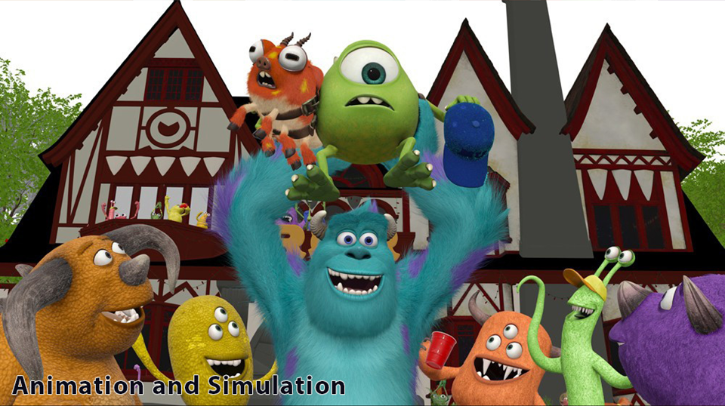
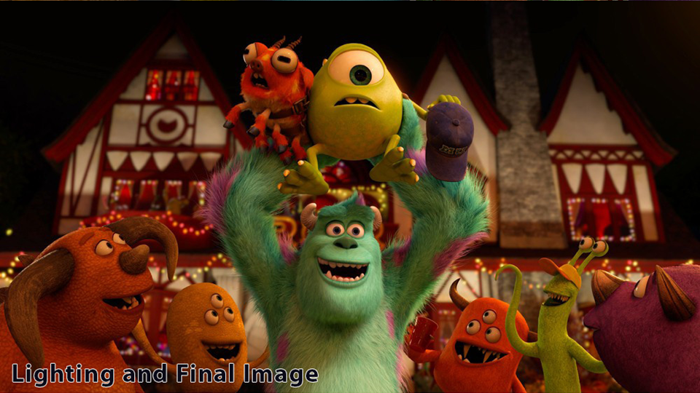
Notes:
Monsters University
Shows progressive refinement

Slide 19
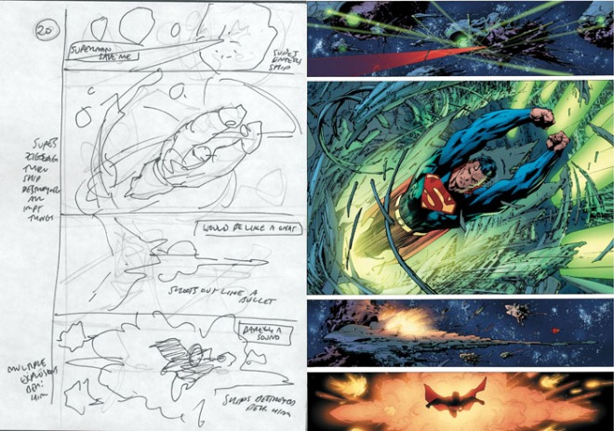
Storyboarding in Other Media
Notes:
Here’s another creative field: comic books.
Note again how it goes from cheap storyboard and layout to more expensive. It would be really expensive to change the things in the fully inked and colored stage (right), but cheap on the sketch stage (left)

Slide 20

Why Use Low-Fi Prototypes?
Building high-fi prototypes takes a lot of time
Build prototype → evaluate → iterate
However, don’t want to spend weeks or months doing programming or design before feedback
Remember design philosophy: fail fast
Alternative: Simulate prototype in early stages
Sketches → evaluate → iterate
Sketches act as prototypes

Slide 21
Why Use Low-Fi Prototypes?
Kindergarten implementation skills
Lets non-programmers participate
Helps make sure everyone on team is on same page
Good team-building exercise too
Takes only a few hours
No expensive equipment needed
Can test multiple alternatives
Fast iterations
Almost all interaction can be faked

Slide 22
Avoid High-Fidelity Prototypes in Early Stages of Design (1/3)
High-fi leads to wrong kind of feedback
Representation communicates “finished”
Comments focus on details like color, fonts, alignment versus interaction flow, missing information, etc
“When can we have it?”

Slide 23
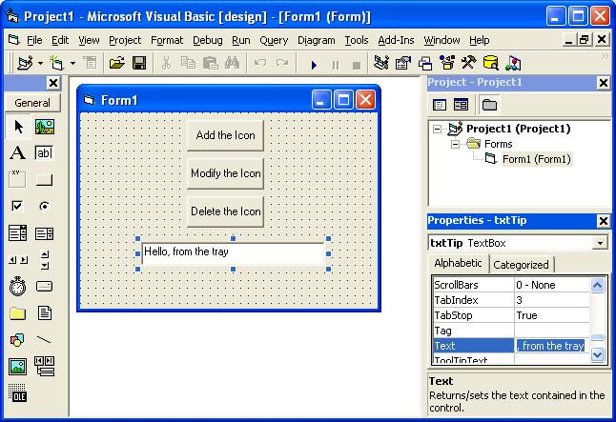
Avoid High-Fidelity Prototypes in Early Stages of Design (2/3)
High-fi prototypes take more time to make
High-fidelity tools (almost all tools) encourage precision (color, alignment, fonts)
Tend to waste time on small details that aren’t important in early stages of design

Slide 24
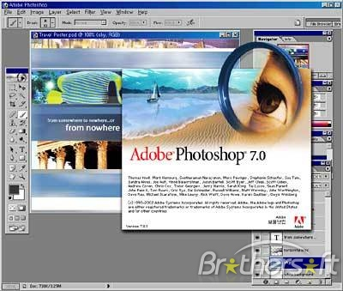
Avoid High-Fidelity Prototypes in Early Stages of Design (3/3)
Starting with high-fi prototypes can lead to less creativity
People tend to focus narrowly on one design with high-fidelity tools
Go very deep instead of broad
Easy to lose track of the big picture
In early stages of design, start broadly
Explore lots of different ideas first
All this mostly true for prototyping tools too

Slide 25
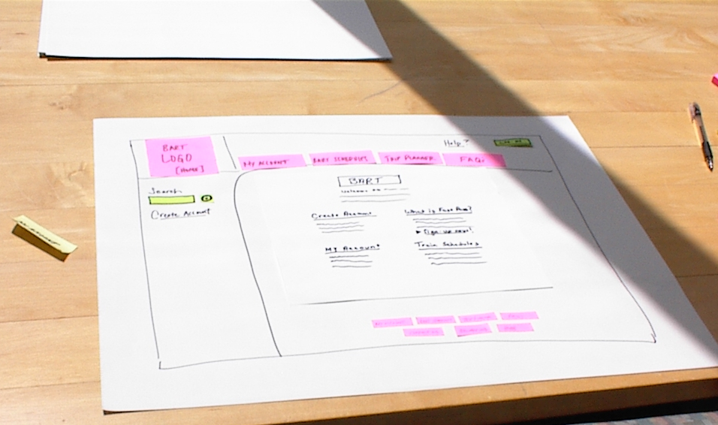
Basic Materials for Low-Fi Paper Prototypes
Large, heavy, white paper (11 x 17)
5x8 in. index cards
Post-its
Tape, stick glue, correction tape
Pens and markers (many colors & sizes)
Overhead transparencies
Scissors, X-acto knives

Slide 26
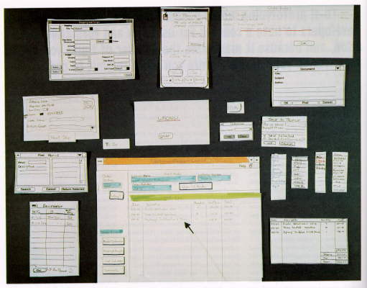
from “Prototyping for Tiny Fingers” by Rettig

Slide 27
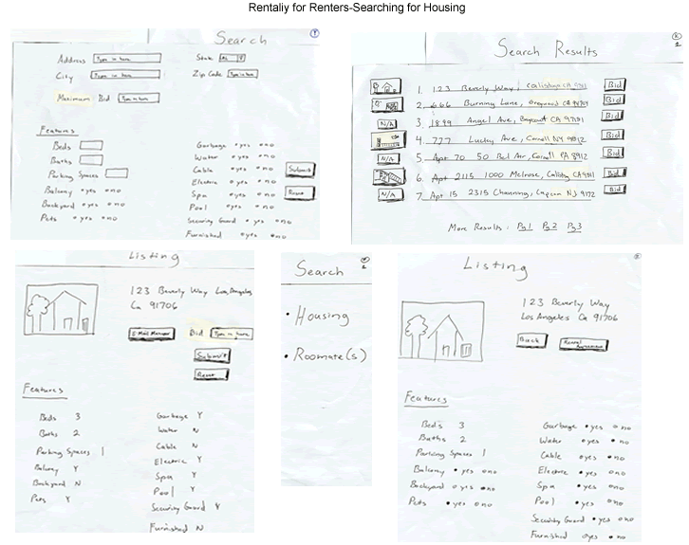

Slide 28
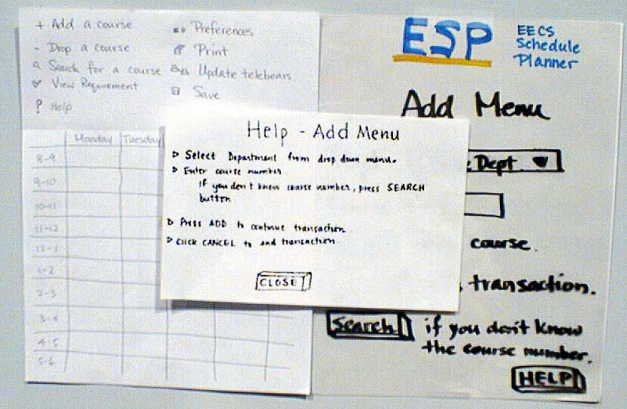
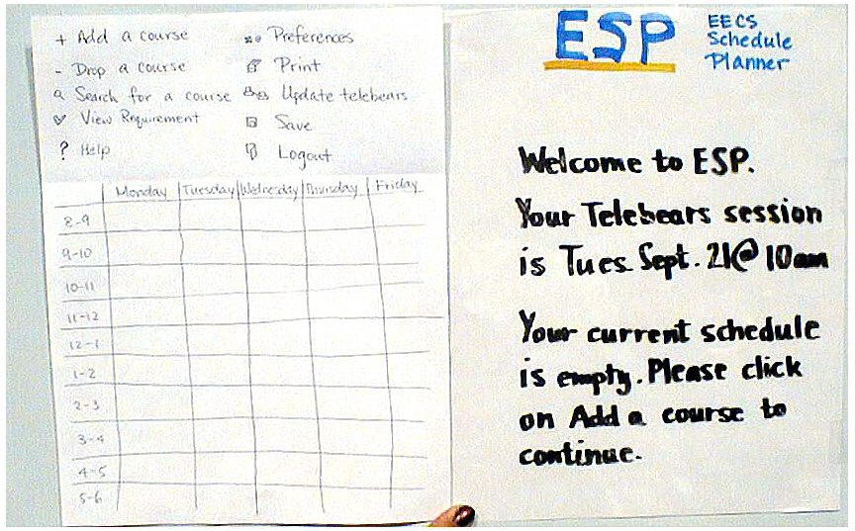
ESP

Slide 29
Constructing the Paper Prototype
Set a deadline for yourself or your team
A few hours or a day, don’t overthink it - build it!
Minimizes analysis paralysis and perfectionism
Have a bias towards action
Draw a window frame on large paper
Put different screen regions on cards
Anything that moves, changes, (dis)appears
Ready response for any user action
E.g., have those pull-down menus already made
Use photocopier to make many versions
Notes:
Lots of students these days have a tendency to think, talk, talk more, think more, and keep talking, but not do.
Have a bias towards action

Slide 30
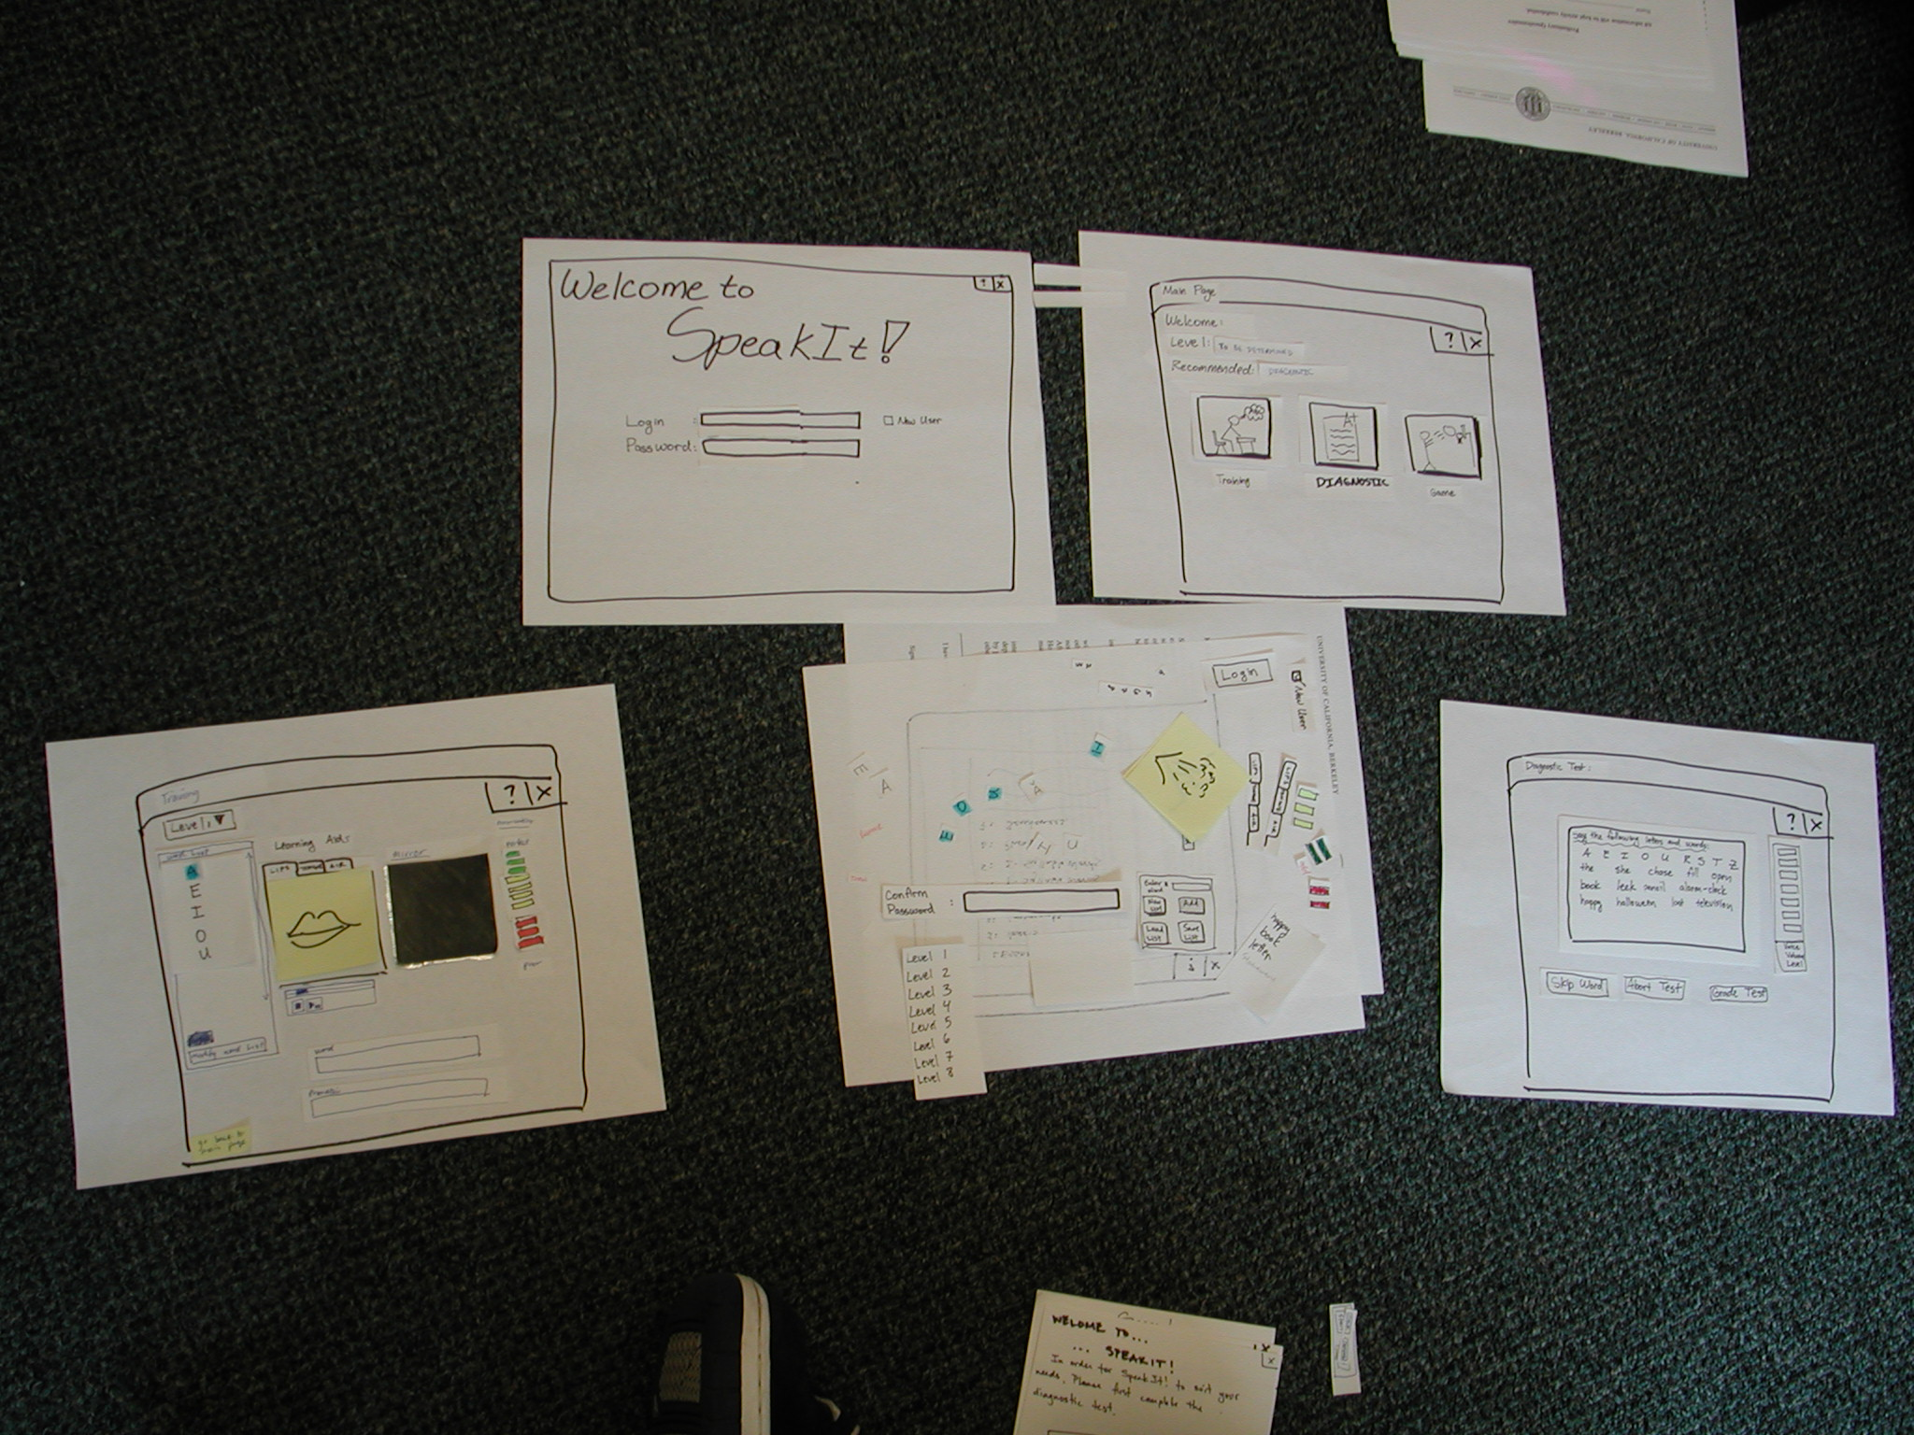
Constructing the Paper Prototype

Slide 31
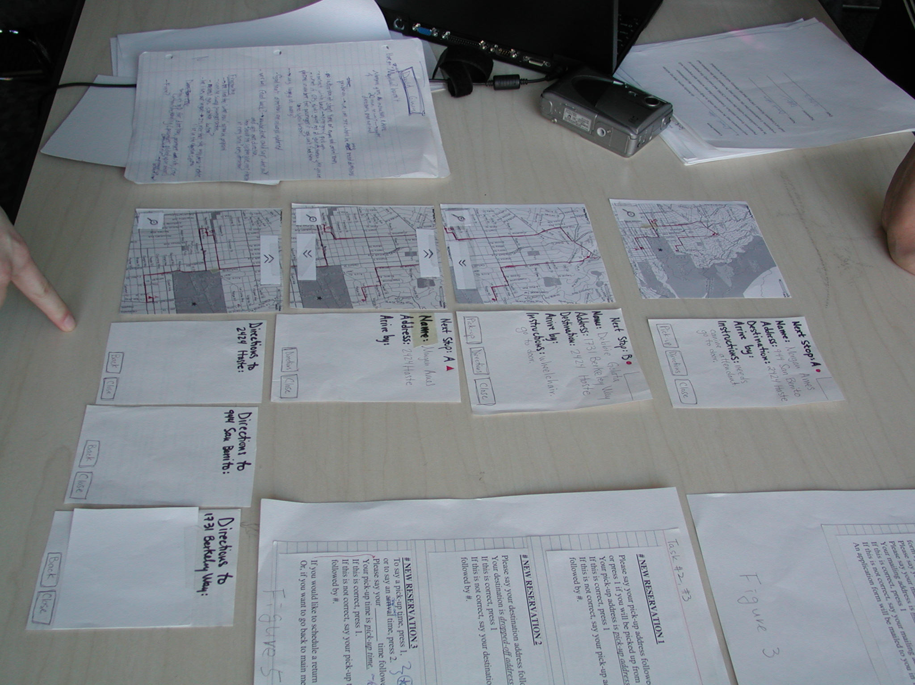
Constructing the Paper Prototype

Slide 32
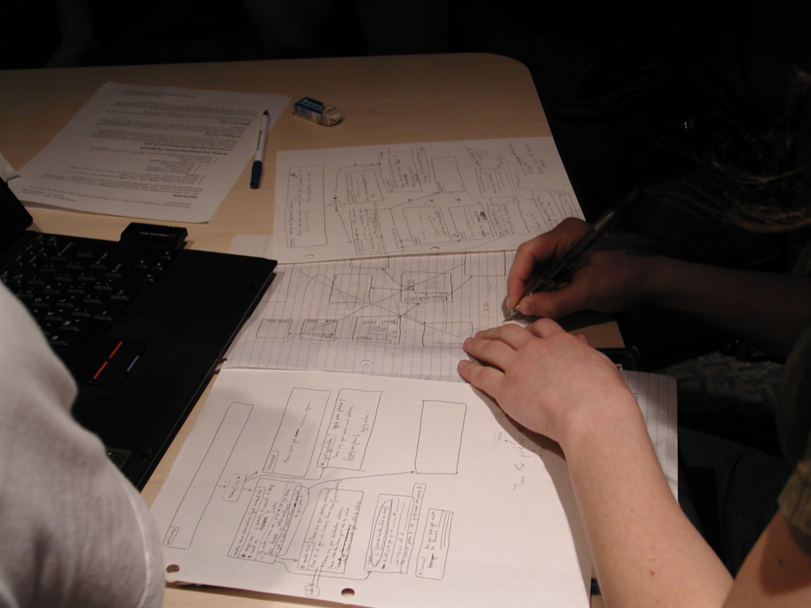
Constructing the Paper Prototype

Slide 33
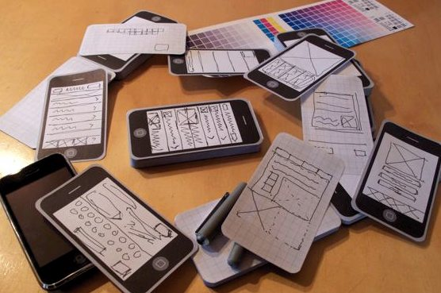
Constructing the Paper Prototype

Slide 34
Wizard of Oz Technique
“Wizard of Oz” means faking the interaction
Where does this term come from?

Slide 35
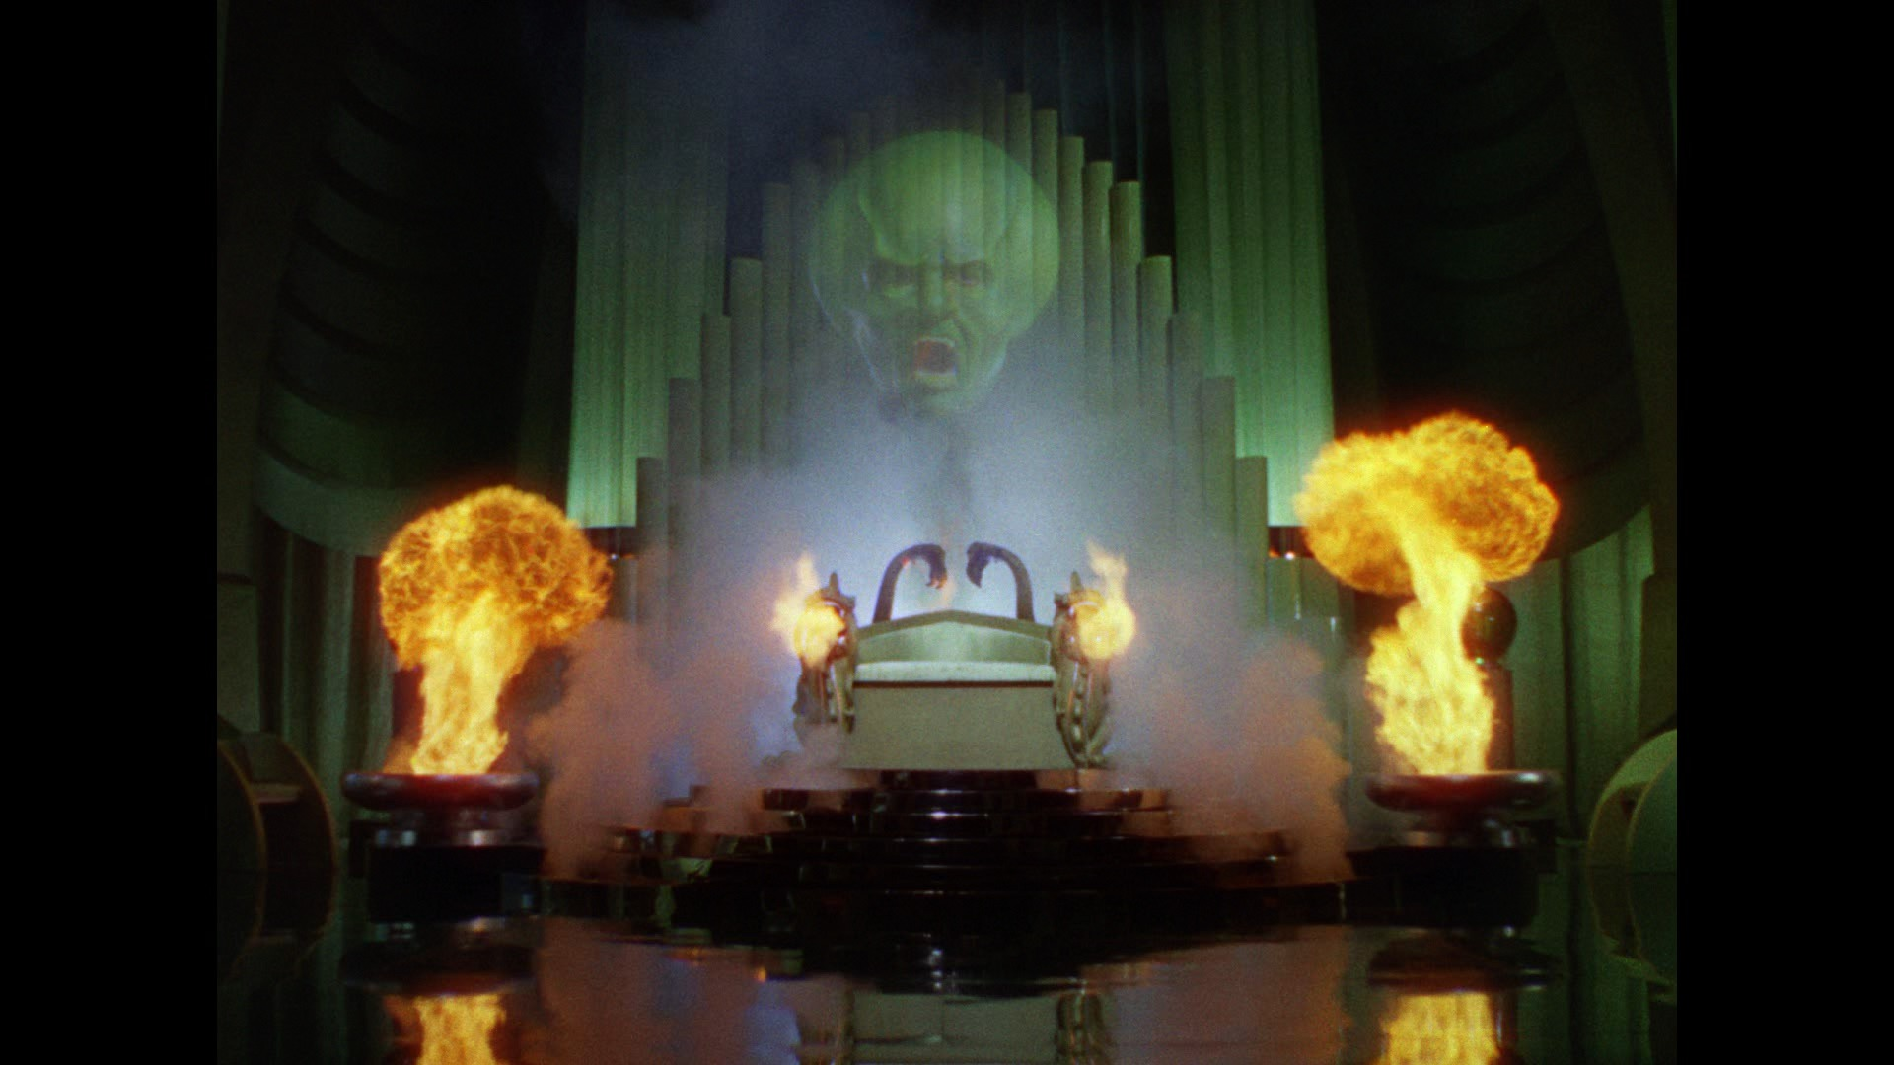
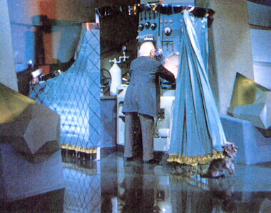
Wizard of Oz Technique
“Wizard of Oz” means faking the interaction
The film “The Wizard of OZ”
“The man behind the curtain”

Slide 36
Wizard of Oz Technique
Long tradition of WOz in computer industry
Ex. Prototype of a PC w/ a VAX behind the curtain
Ex. Speech user interfaces
Often used for hard to implement features
Speech and handwriting recognition
Augmented reality
Internet of Things
More on this in Advanced Prototyping in ~2 weeks

Slide 37
Note: WOz and Lo-Fi Prototyping not the same thing
Lo-fi prototyping is the act of creating rough and ready prototypes
Wizard of Oz is the process of faking interactions to do early-stage testing with users
Complementary techniques
Could create lo-fi prototype but not do WOz testing
Could do WOz testing with lo-fi or even high-fi prototypes
Notes:
Might want to reiterate on Wizard of Oz a few times, how it is different from just paper prototyping. Especially among students who lacked the cultural reference, I remember many students did not understand the concept by the midterm, at least last fall.

Slide 38
Problems with Low-Fi Prototypes
“Computer” inherently buggy
Slow compared to real app, timing not accurate
Hard to implement some functionality
Animation, feedback, drag, etc
End-users can’t use by themselves
Not in context of user’s work environment
Can’t show low-fi to clients
What are we paying you for?”

Slide 39
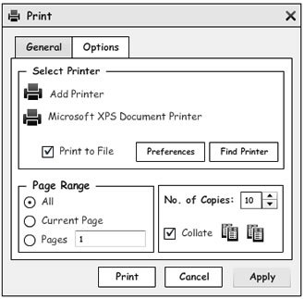
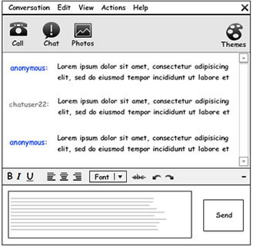
Medium-Fidelity Prototypes
Basic details and layout, minimal color
Respectable enough to show clients

Slide 40
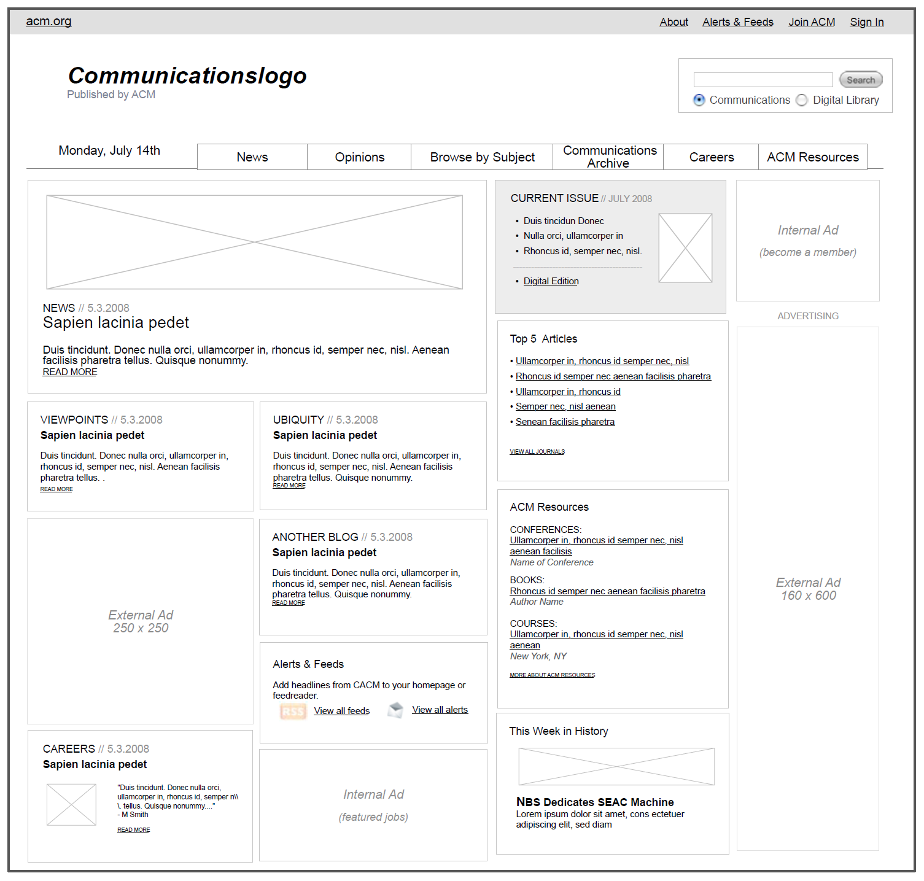
Medium-Fidelity Prototype
Notes:
Communications of the ACM wireframe
(I was on editorial board for web re-design, so this is the real one)

Slide 41
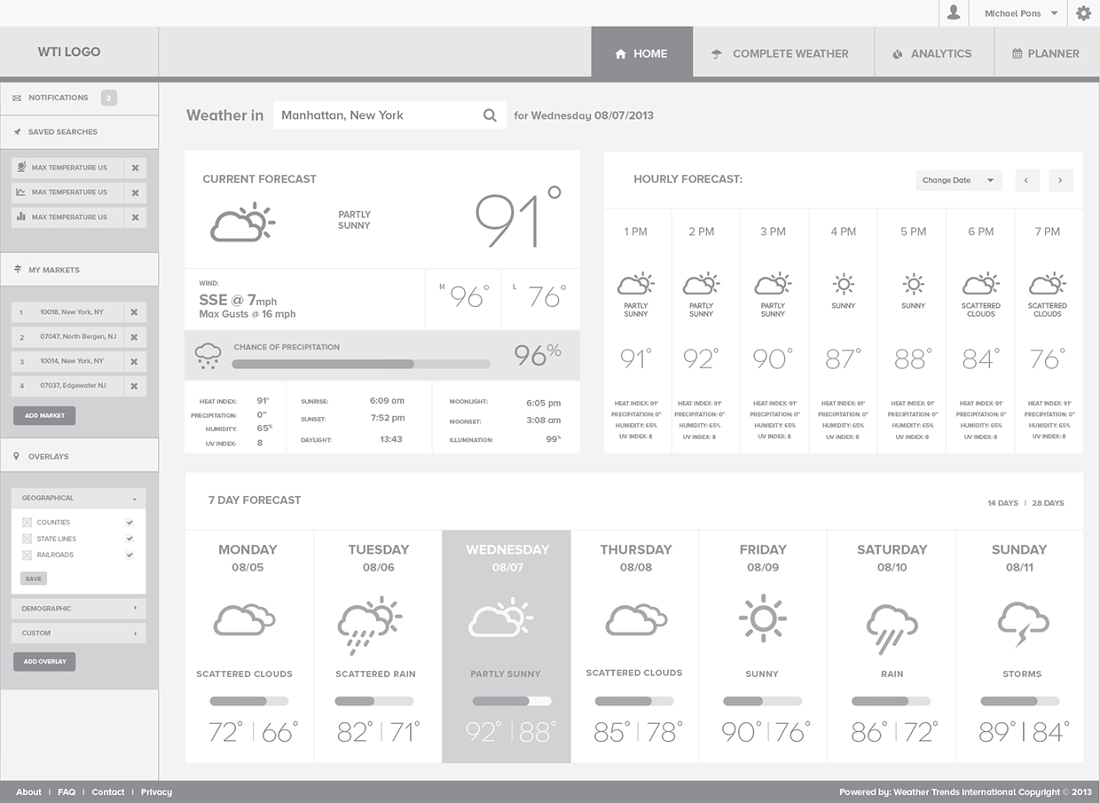
Notes:
This is from one of Skip Shelley’s projects

Slide 42
Administrivia
Update this slide each semester
HW2a and HW2b assigned
Both due Wed Sep 12 @ 11:59pm
Next reading
How to Conduct a Heuristic Evaluation
Heuristic Evaluation and Expert Reviews
Entrepreneurship Boot Camp, Sat Sep 8 (free)
https://t.e2ma.net/click/peg06/xgr0ug/529bgq
Product Camp Pittsburgh, Sat Sep 22 (free)
https://www.pghpcamp.com/
Notes:
https://www.nngroup.com/articles/how-to-conduct-a-heuristic-evaluation/
https://www.usability.gov/how-to-and-tools/methods/heuristic-evaluation.html

Slide 43
Administrivia
HW0
Looks like everyone passed, good work
Don’t worry about specific grade, pass/fail (and not part of your final grade)

Slide 44
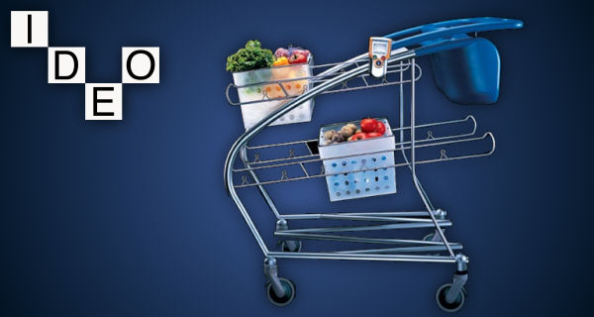
IDEO Shopping Cart
http://www.youtube.com/watch?v=M66ZU2PCIcM

Slide 45
Overview of Today
Why Prototype?
Low-fidelity and High-fidelity Prototypes
Paper Prototyping
Wizard of Oz
Some advanced prototyping concepts
Running user studies

Slide 46
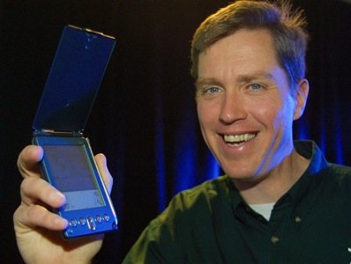
d
Bodystorming: physically go and pretend what it would be like
Think improv + design
Notes:
The core idea to bodystorming is to physically go and pretend you have the system you want, to fake the experience of what it might be like to have it. It’s sort of like improv coupled with design.
For example, when Jeff Hawkins was inventing the Palm Pilot (the picture shown), he carried around a block of wood and post-it notes for days, and would write down things on the post-it note to simulate either saving information or to write down what information would have been really useful then. Basically, he used this approach to simulate and experience the feel of what it might be like to have a Palm Pilot PDA before it was invented.
Picture is from: http://www.businessinsider.com/irreplaceable-what-happened-to-10-tech-companies-when-they-lost-their-founders-2011-8?op=1

Slide 47
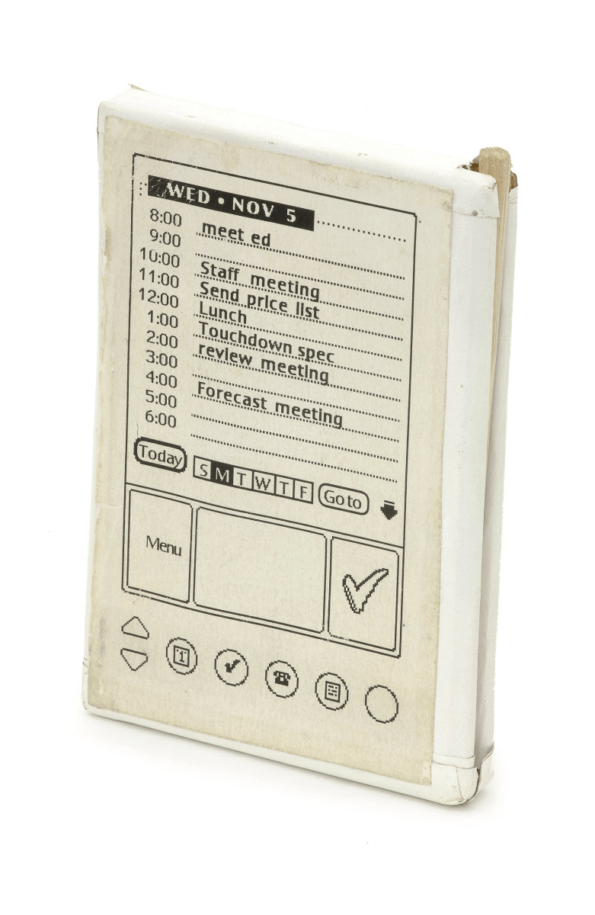
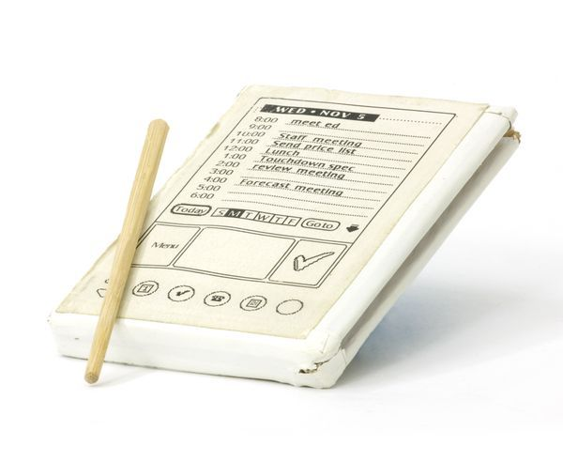
Q: Does this approach contradict “you are not the user”?
Notes:
Original Palm Pilot block of wood, in the computer history museum
http://www.computerhistory.org/revolution/mobile-computing/18/321/1648
In this case, Jeff Hawkins really was a prototypical user. Designing things for people like yourself is ok. This kind of bodystorming can be a good way of validating assumptions and working out early bugs. But don’t stop here either. Try out with other people too. Don’t ignore your intuitions and experiences, but do be sure to validate your assumptions and ideas.

Slide 48
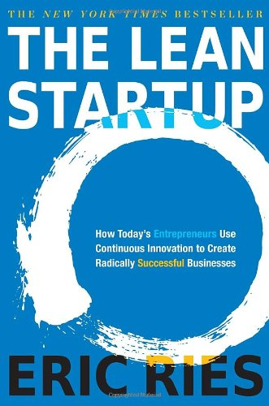
Slight Tangent: Lean Startup
UX thinking combined with business thinking packaged for Silicon Valley
Book and terminology popular in SV
“Because startups often accidentally build something nobody wants, it doesn’t matter much if they do it on time and on budget.”
“The goal of a startup is to figure out the right thing to build—the thing customers want and will pay for—as quickly as possible.”
Notes:
“The goal of a startup’s early efforts should be to test [assumptions] as quickly as possible”

Slide 49
Lean Startup Three Concepts If You Want to Fake It
Value hypothesis
Test whether a product or service really delivers value to customers once they are using it
Again, distinction between UX vs UI
Treat it scientifically (validate assumptions)
Minimum Viable Product (MVP)
Version of product that enables a full turn of Build-Measure-Learn loop with minimum of effort and dev

Slide 50
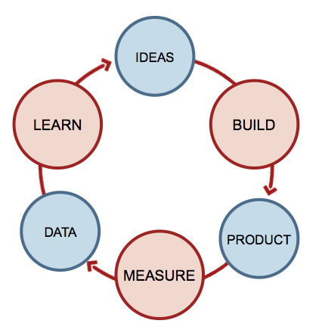
Lean Startup Three Concepts If You Want to Fake It
Use the Build- Measure-Learn process to validate your value hypotheses
Minimize your total time in this loop

Slide 51
Lean Startup Dropbox Example
“The challenge was that it was impossible to demonstrate the working software in a prototype form.” [technical hurdles, uptime]
“To avoid the risk of waking up after years of development with a product nobody wanted, Drew did something unexpectedly easy: he made a video.”
“The video was the minimum viable product.”

Slide 52

https://www.youtube.com/watch?v=7QmCUDHpNzE
Notes:
Dropbox concept video as MVP

Slide 53
Lean Startup Aardvark Search Engine
“We self-funded the company and released very cheap prototypes to test. What became Aardvark was the sixth prototype. Each prototype was a two- to four-week effort. “
“We used humans to replicate the back end as much as possible. We invited one hundred to two hundred friends to try the prototypes and measured how many of them came back. The results were unambiguously negative until Aardvark.”
Notes:
Refers to the Aardvark search engine, where you could ask questions to your friend network. Was bought out by Google for $50m.
Was unfortunately shut down later on.

Slide 54
Lean Startup Aardvark Search Engine
“Imagine a service that allowed customers to ask questions of human researchers—for free—and expect a real-time response. Such a service (at scale) would lose money, but it is easy to build on a micro scale.” [Note Wizard of Oz approach]
“If we can solve the tough technical problems behind this artificial intelligence product, will people use it? Will their use lead to the creation of a product that has real value?”
Notes:
Refers to the Aardvark search engine, where you could ask questions to your friend network. Was bought out by Google.

Slide 55
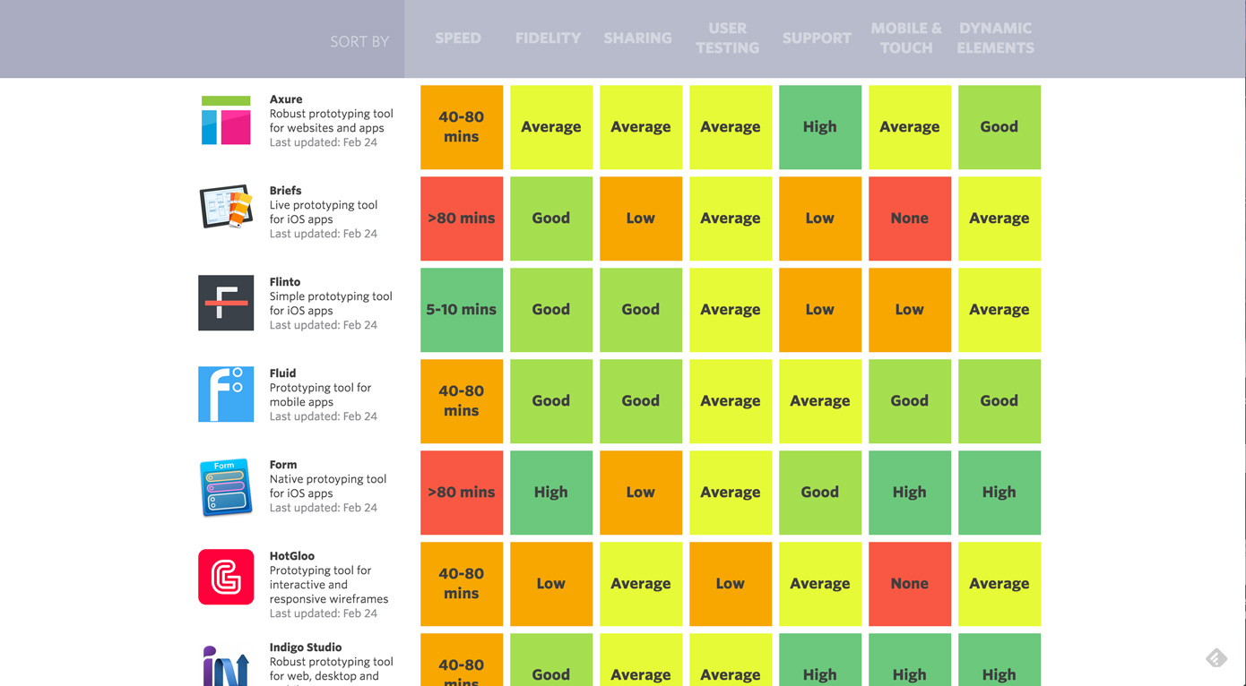
Modern Prototyping Tools
Lots of tools out there, check out comparison at Cooper Design
https://www.cooper.com/prototyping-tools
Notes:
Designed in part by MHCI alum Emily Schwartzman

Slide 56
Modern Prototyping Tools
No support for transition to high-fidelity or actual working implementations
From conversations with designers, they saw little value in a tool that could help in this transition
Usually, devs just build from ground up based on the interactive prototypes or design spec

Slide 57
Overview of Today
Why Prototype?
Low-fidelity and High-fidelity Prototypes
Paper Prototyping
Wizard of Oz
Some advanced prototyping concepts
Running user studies

Slide 58

Preparing for a User Test
Select people representative of target users
Minimize use of friends or family
Choose people with right job-specific vocabulary / knowledge, approximate if needed
Medical students, engineering students
Use incentives to get participants
T-shirts, mugs, gift certificates
Prepare tasks typical of the product during actual use
Practice to avoid “bugs”

Slide 59
Roles in Conducting a User Test
Greeter
Puts users at ease and gets demographic data
Facilitator
Only team member who speaks
Gives instructions, encourages thinking aloud
Computer
Simulates feedback and response (WOz)
Observers
Take notes and recommendations

Slide 60


Conducting a User Test
Typical session is 1 hour
Preparation, the test, debriefing
Make a recording or take good notes
Can use camera, video camera, audio recorders

Slide 61
Instructions to Participants
Describe purpose of evaluation
“I’m testing the product; I’m not testing you”
Tell them they can quit at any time
Demonstrate any equipment and how to use
Explain how to think aloud
Tell us what they are trying to do
Tell us questions that arise as they work
Tell us things they read
Notes:
Can add funny digression about study done by MIT Media Lab, to help incentivize students they did say that they were testing the intelligence of the students

Slide 62

Instructions to Participants
Explain that you will not provide help
Explain basic concept of UI, but not too much
Describe the task
Give written instructions, one task at a time
Also common to ask participants to read task aloud
This gets them into mindset of thinkaloud protocol

Slide 63
Ethical Considerations
Sometimes tests can be distressing
Users have left in tears
You have a responsibility to alleviate
Make voluntary with informed consent
Avoid pressure to participate
Let them know they can stop at any time
Stress that you are testing system, not them
Anonymize collected data
Often must get human subjects approval (IRB)
Notes:
Can tell some IRB horror stories, plus if not careful, not only can harm individuals, can shut down all research at an organization

Slide 64

Conducting a Test
Do a debriefing at the end
What did they like the least about the UI? Best?
Get participants to be critical at start
Were tasks realistic?
What parts made sense? Confusing?
Any features missing?

Slide 65
Evaluating Results
Sort and prioritize observations
What was important?
Lots of problems in the same area?
Create a written report on findings
Gives agenda for meeting on design changes
Make changes and iterate on your design
Again, note similarity between iterative design and Lean Startup philosophy

Slide 66
Summary of Today
Low- vs Medium- vs High-Fidelity
Pros and Cons of Low-Fidelity Paper Prototyping
What is Wizard of Oz
Connecting UX with Lean Startup / Agile
Other kinds of prototyping
Bodystorming
Video prototypes
Running user studies
Notes:
Pro
Focus on useful details (not font, color)
Don’t need working prototype
Cheap and quick
Multiple people working on it
Cons
Hard to suspend disbelief
Might not have enough details / interaction / might not capture essence (ex. if color is impt)
Feasibility of actually building the prototype
What the heck are we paying you for?
Functionality hard to simulate (search, animation)

Slide 67
Example Exam Questions (Not complete)
What are two advantages of low-fidelity prototypes (over high-fidelity)?
And the opposite question
Name at least two things you should do in user studies with respect to ethical concerns
What is Wizard of Oz in the context of prototyping? Why is it useful? When would you use it?
What is a minimal viable product (MVP)?
There are typically 4 roles for running user studies, name two and describe what they do

Slide 68
Action Items
Next reading, do before class on Tuesday
How to Conduct a Heuristic Evaluation https://www.nngroup.com/articles/how-to-conduct-a-heuristic-evaluation/
Heuristic Evaluation and Expert Reviews https://www.usability.gov/how-to-and-tools/methods/heuristic-evaluation.html
HW2a and 2B assigned
Due Wed Sep 12 @ 11:59pm
Do competitive analysis
Extend your paper prototype
Do user testing with others in class (assigned)
Update each semester

